Slide 1
Employee Data Analysis using Excel
STUDENT NAME
REGISTER NO
NM ID DEPARTMENT COLLEGE
: PRADEEP KUMAR S
: 312213168
: asunm1455251122235
: B COM (ACCOUNTATING & FIANANCE )
: TAGORE OF COLLEGE ARTS & SCIENCE CHROMPET ,CHENNAI - 44

Slide 2
PROJECT TITLE
Employee Performance Analysis using Excel

Slide 3


AGENDA
Problem Statement
Project Overview
End Users
Our Solution and Proposition
Dataset Description
Modelling Approach
Results and Discussion
Conclusion
3/21/2024 Annual Review

Slide 4

PROBLEM STATEMENT
IDENTIFY THE KEY FACTORS THAT CONTRIBUTE TO HIGH EMPLOYEE PERFORMANCE WITHIN OUR ORGANIZATION

Slide 5

PROJECT OVERVIEW
THE PROJECT AIMS TPO ANALYSE VARIOUS EMPLOYEE ATTRIBUTES AND WORKPLACE FACTORS TO UNDERSTASND THEIR IMPACT ON EMPLOYEE PERFORMANCE. THE FINDINGS WILL INFORM HR POLICIES, TRAINING PROGRAMS,AND MANGAEMENT PRACTIES TO FOSTER A HIGH – PERFORMING WORK FORCE.

Slide 6

WHO ARE THE END USERS?
HR PROFESSIONLS
MANGEMENT
EMPLOYEE

Slide 7

OUR SOLUTION AND ITS VALUE PROPOSITION
CONDATIONAL FORMATING – MISSING CELL PIVOT – SUMMARY
FORMULA – PERFORMANCE GRAPH – DATA VISULIZATION FLITER – REMOVE MISSING CELL

Slide 8
Dataset Description
EMPLOYEE DATA SET = NAAN MULDHAVAN 26-FEATURE
EMPLOYEE ID
FIRST & LAST NAME EMPLOYEE TYPE GENDRE PERFORMANCE LEVEL EMPLOYER RATING

Slide 9

THE "WOW" IN OUR SOLUTION
•=IF(Z14>=5,"VERYHIGH",IF(Z14>=4,"HIGH",IF(Z14>=3,"MEDIUM","LOW ")))
THE FORMULA USED FOR CALCULATION OF PERFORMANCE LEVEL
3/21/2024 Annual Review

Slide 10
MODELLING
DATA COLLECTION
SOURCE NAAN MULDHAVAN FEATURE COLLECTION
NAME ,PERFORMANCE LEVEL ,SALRY,JOB FUNCTION ,DEPARTMENT ,ACTIVE STATUS ETC DATA CLEANING
REMOVE MISSING VALUES
CONVERT CATEGORICALS VARIABLE INTO NUMERCIAL FORMAT PERFOMANCE LEVEL SEGEMENTED ON THE BASIS OF
VERY HIGH
HIGH
MEDIUM
LOW

Slide 11
MODELLING
SUMMARY
THIS ANALYSIS USED EXCEL TO ANALYSE EMPLOYEE PERFORMANCE DATA COLLECTED FROM THE MUDHALVAN PORTAL . KEY FEATURE INCULDED ,PERFORMANCE LEVEL WERE CATEGORIZED USING IF FORMULA AND VISULATION IN A PIVOT TABLE . THIS ANALYSIS PROVIDES INSIGHSTS INTO EMPLOYEE PERFORMANCE DISTRIBUTION AND CAN INFORM HR STRATEGIES FOR IMPROVEMENT .

Slide 12
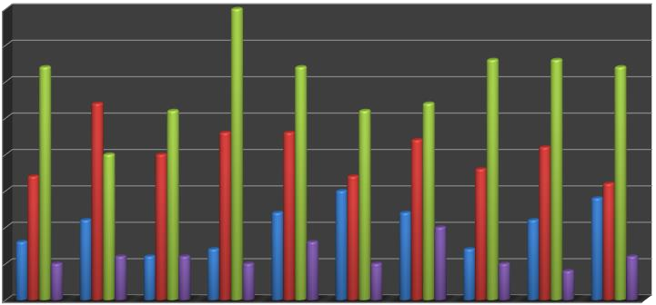
RESULTS
EMPLOYEE PERFOMANCCE ANALYSIS
40
35
30
25
20
15
HIGH LOW MEDIUM
VERY HIGH
10
5
0
BPC
CCDR
EW
MSC
NEL
PL
PYZ
SVG
TNS
WBL
12

Slide 13
conclusion
THE RESULTS DEMONSTRATE THAT OUR TRAIINING PROGRAMS ARE VALUABLE IN IMPROVING EMPLOYEE SKILL AND PERFORMANCE .

